Slide 1
PROVISIONING FRAMEWORK
05/06/2022

Slide 2
WHAT’S THE PROBLEM?

Slide 3
CUSTOMER & USE CASE
Why a Provisioning Framework?
Standardize Object Creation
Naming Conventions
Access Management
Compliance Requirements

Slide 4
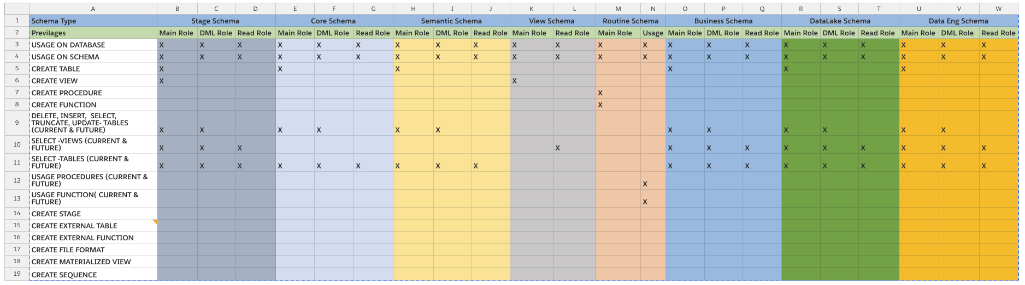
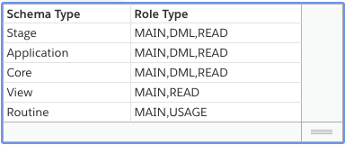
SPECIFIC REQUIREMENTS & CHALLENGES

Slide 5
PROVISIONING EXAMPLE
A request to create a schema named STARLING in CIDE_BOM SEMANTIC database
Database | Schemas | Permissions | Roles | Users | Warehouses
CIDE_BOM_SEMANTIC_DB | STARLING_ITEM_APP | TABLE, PIPE, STREAM, TASK,FILE FORMAT, SEQUENCE, STAGE,EXTERNAL TABLE,MATERIALIZED VIEW | CIDE_BOM_SEMANTIC_DB_STARLING_ITEM_APP_MAIN_ROLE | CIDE_BOM_SEMANTIC_DB_STARLING_ITEM_USER CIDE_BOM_SEMANTIC_DB_STARLING_ITEM_CR_USER | CIDE_BOM_SEMANTIC_VWH
 |  |  | CIDE_BOM_SEMANTIC_DB_STARLING_ITEM_APP_DML_ROLE
 |  |  | CIDE_BOM_SEMANTIC_DB_STARLING_ITEM_APP_READ_ROLE
 | STARLING_ITEM | VIEW | CIDE_BOM_SEMANTIC_DB_STARLING_ITEM_MAIN_ROLE
 |  |  | CIDE_BOM_SEMANTIC_DB_STARLING_ITEM_READ_ROLE
 | STARLING_ITEM_ROUTINE | PROCEDURES, FUNCTIONS | CIDE_BOM_SEMANTIC_DB_STARLING_ITEM_ROUTINE_MAIN_ROLE
 |  |  | CIDE_BOM_SEMANTIC_DB_STARLING_ITEM_ROUTINE_USAGE_ROLE

Slide 6
WHAT DID I DO?

Slide 7
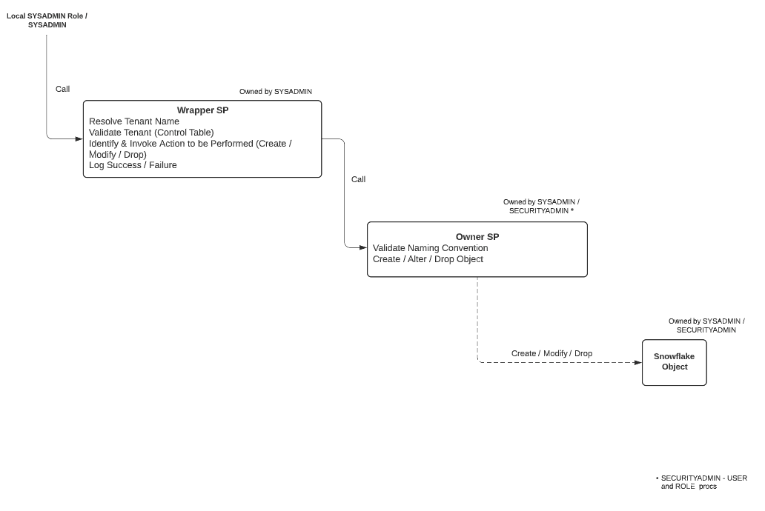
WRAPPER DESIGN
Stored procedures are owned by the Admin team
Tenant Sysadmins are granted permissions to execute Wrapper stored procedures
Wrapper procedures resolve, validate the tenant name and call the owner stored procedure to create the object
Control Table is used to maintain the approved list of tenants that can use the framework

Slide 8
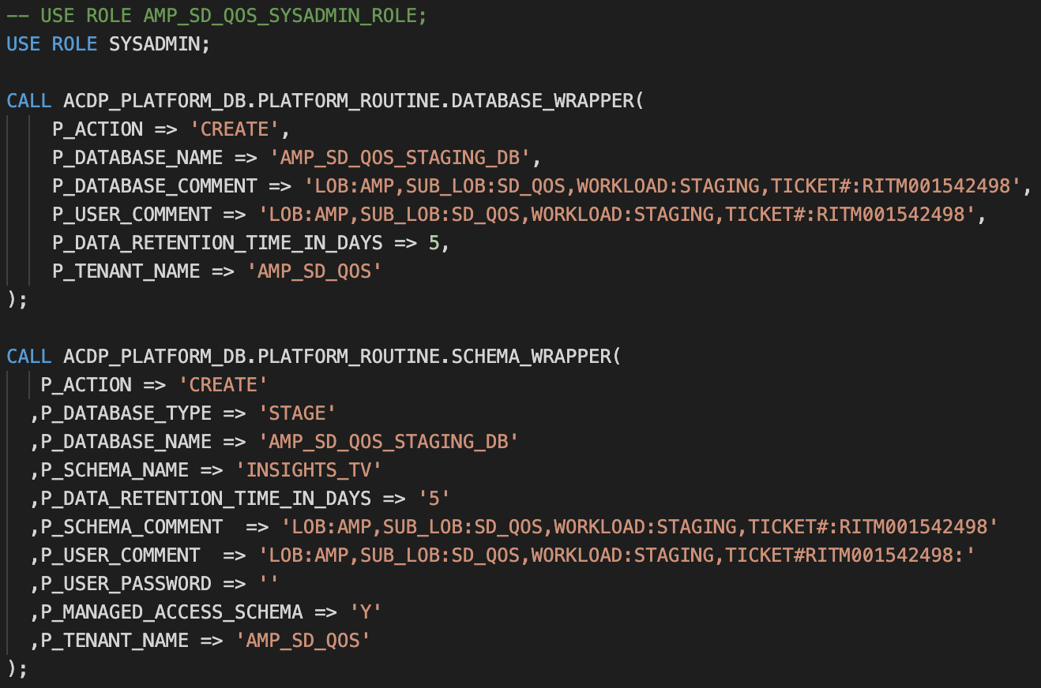
CALLING A WRAPPER SP

Slide 9
STORED PROCEDURE INVENTORY
Resource Monitor Wrapper
Warehouse - Create
Warehouse - Drop
Warehouse - Modify
Warehouse Wrapper
Warehouse - Create
Warehouse - Drop
Warehouse - Modify
Warehouse - Resource Monitor Attach.
Database Wrapper
Database - Create
Database - Drop
Database - Modify
Schema Wrapper
Schema - Create
Schema - Drop
Schema - Modify
Role Wrapper
Role - Create
Role - Drop
Role - Modify
Role - Grant
Role - Revoke
User Wrapper
User - Create
User - Drop
User - Modify
User - Reset Password
User - Unlock
User - Rotate Keypair
User - Enable / Disable
Storage Integration Wrapper
Integration - Create
Integration - Drop
Integration - Modify

Slide 10
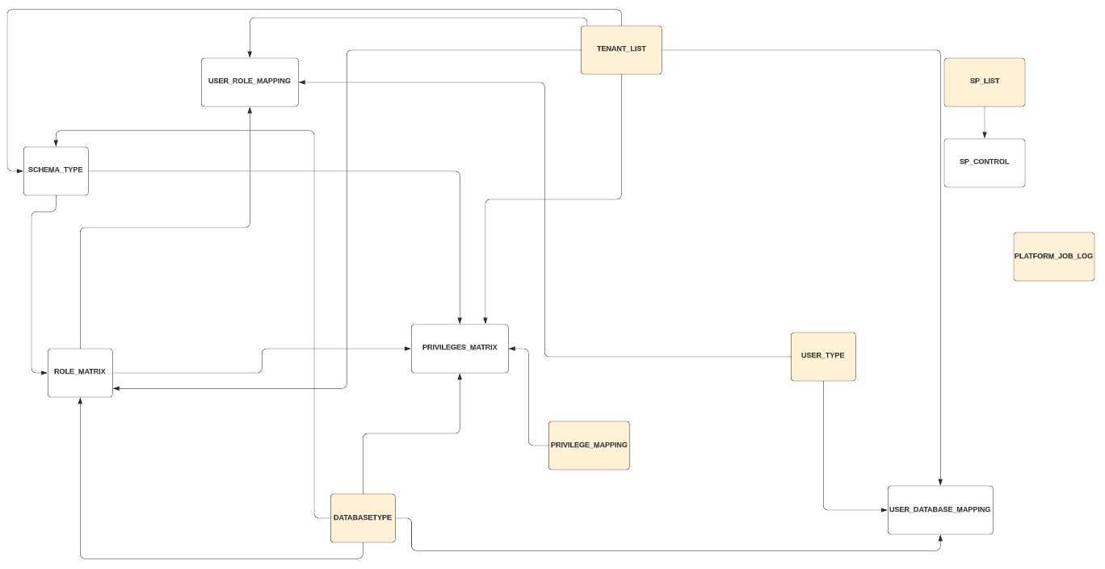
METADATA MODEL

